Slide 1
e-IRG
Panos Argyrakis
GRNet, University of Thessaloniki
Greek Representative to the e-IRG Committee
e-IRG vice-Chair

Slide 2
e-IRG is the ESFRI of computers
but
has UNIQUE character
because there are computational needs
in all 48 ESFRI projects

Slide 3
The e-Infrastructure Reflection Group
Founded to provide strategic advice and guidance on the development of European e-infrastructure for science and research
to:
EC, MS governments, ESFRI, national funding agencies
Policy-makers on the (inter-)governmental level
e-Infrastructure service-providers
Research networks, computing centers, projects
User communities and research infrastructures
ESFRI projects, data infrastructures
Technology developers and industry

Slide 4
The e-Infrastructure Reflection Group
Delegates appointed by ministries – represents nations (EU member states and associated states + EC).
Bylaws: www.e-irg.eu/images/stories/about-e-irg/ e-irg_bylaws_120914-approved.pdf
First meeting (in Athens) June 2003
Four delegates meetings and two open workshops each year
Analyses the future foundations of the European Knowledge Society, and produces roadmaps, white papers and task-force reports including recommendations
Secretariat: Provided by support projects, currently e-IRGSP4 (~ 6-8 partners, GR is one of them)

Slide 5
e-Infrastructure
networking
high-throughput
high-performance computing
data infrastructures
software
authentication and authorization and
tools and services for international virtual research communities
Note the wide scope: e-Infrastructure supports research (all types) and other research infrastructures (all types)

Slide 7
The e-Infrastructure Commons
Roadmap 2012: Outlines Europe’s need for a single e-Infrastructure Commons
White Paper 2013: Further discussion and recommendations
Dublin May 2013 – issues in the WP discussed at open workshop
European services on data
Coordination of e-Infrastructures
July 2013 – Final version of WP accepted

Slide 9
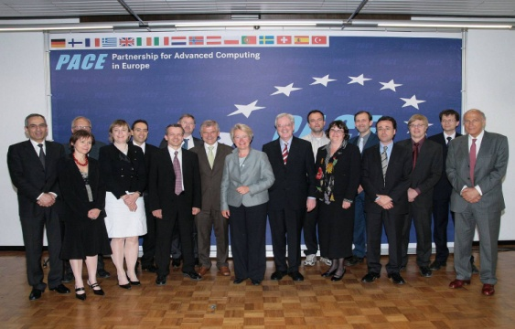
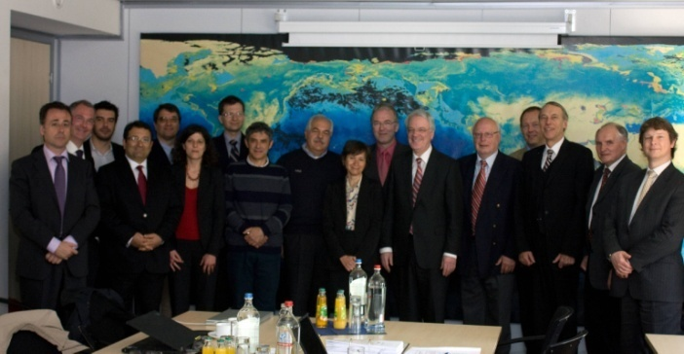
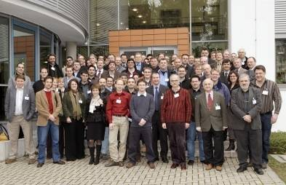
PRACE History
HPC part of the ESFRI Roadmap; creation of a vision involving 15 European countries
http://www.imdb.com/title/tt1615147/
Creation of the Scientific Case
Signature of the MoU
Creation of the PRACE
Research Infrastructure
HPCEUR
HET
PRACE Initiative
PRACE RI
2004
2005
2006
2007
2008
2009
2010
2011
2012
2013
2014
PRACE Preparatory
Phase Project
PRACE-1IP
PRACE-3IP
PRACE-2IP

Slide 10
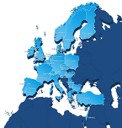
PRACE → the European HPC Research Infrastructure
Enabling world-class science through large scale simulations
Providing HPC services on leading edge capability systems
Operating as a single entity to give access to world-class supercomputers
Attract, train and retain competences
Lead the integration of a highly effective HPC ecosystem
Offering its resources through a single and fair pan-European peer review process to academia and industry
25 members, since 2010
6 supercomputers in 4 hosting countries, nearly 15 Pflop/s
Common operation procedure between 35 centers in Europe
22 prototypes evaluated
169 white papers produced
1500 communications from our users
166 Thesis
HPC Community building: 183 events
8 billion hours granted since 2010 (a system with 900k cores for 1 year)
303 scientific projects enabled from 38 countries
More than 20 SME and industries access in first year
360 PATC Training days
2734 Trained people
170 applications enabled

Slide 11
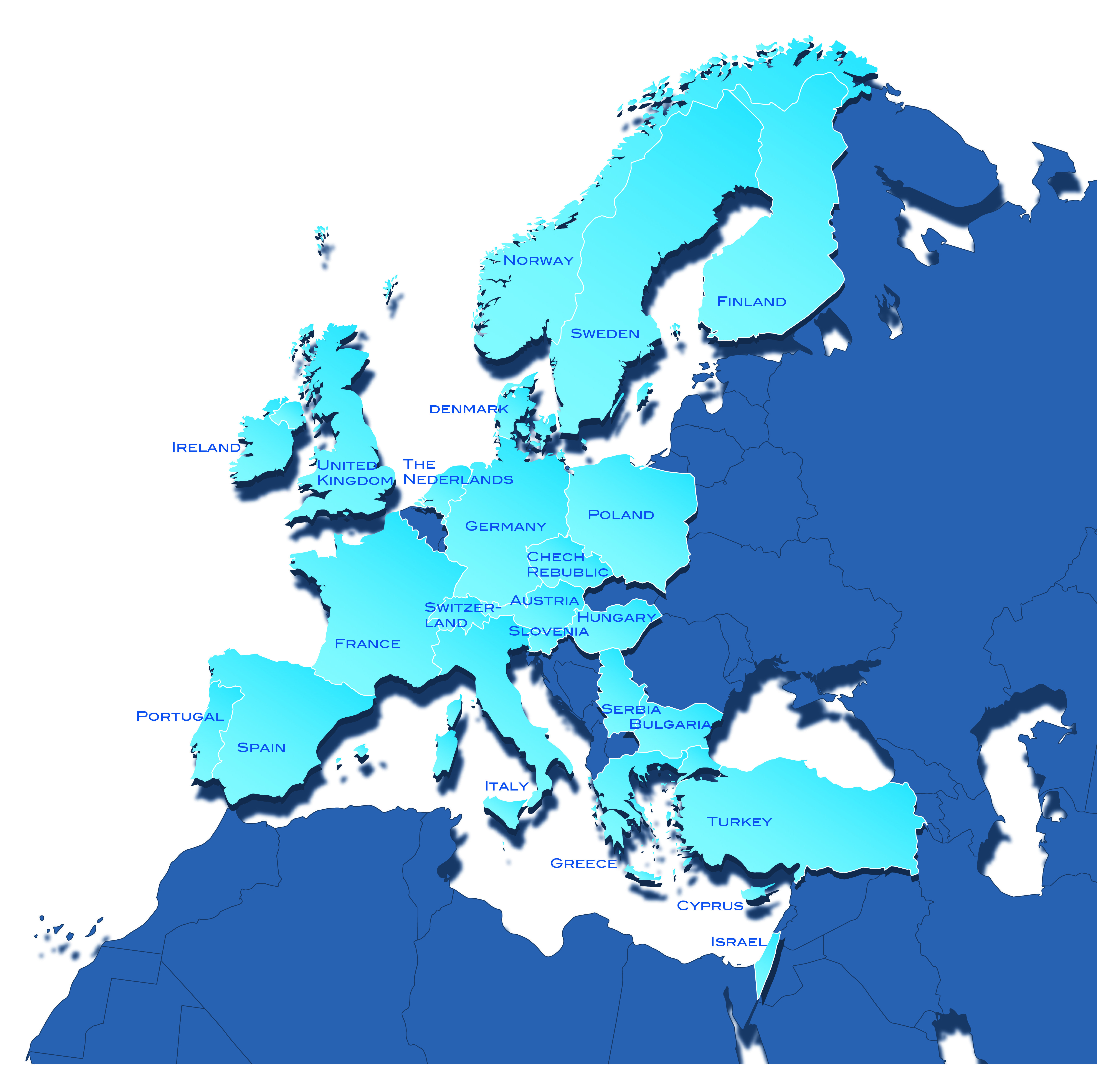
25 PRACE
Members
Legal entity (AISBL) PRACE with seat location in Brussels
Austria: JKU - Johannes Kepler University of Linz
Belgium: DGO6-SPW – Service Public de Wallonie
Bulgaria: NCSA - Executive agency
Cyprus: CaSToRC –The Cyprus Institute
Czech Republic: VŠB - Technical University of Ostrava
Denmark: DCSC - Danish Center for Scientific Computing
Finland: CSC - IT Center for Science Ltd.
France: GENCI - Grand Equipement National de Calcul Intensif
Germany: GCS - GAUSS Centre for Supercomputing e.V
Greece: GRNET - Greek Research and Technology Network S.A.
Hungary: NIIFI - National Information Infrastructure Development Institute
Ireland: ICHEC - Irish Centre for High-End Computing
Israel: IUCC - Inter-University Computation Center
Italy: CINECA - Consorzio Interuniversitario
Norway: SIGMA – UNINETT Sigma AS –
The Netherlands: SURFSARA: SARA Computing and Networking Services
Poland: PSNC – Instytut Chemii Bioorganicznej Pan
Portugal: FCTUC – Faculdade Ciencias e Tecnologia da Universidade de Coimbra
Slovakia: Computing Center of the Slovak Academy of Science
Slovenia: ULFME - University of Ljubljana, Faculty of Mechanical Engineering
Spain: BSC – Barcelona Supercomputing Center – Centro Nacional de Supercomputación
Sweden: SNIC – Vetenskapsrådet – Swedish Research Council
Switzerland: ETH – Eidgenössische Technische Hochschule Zürich
Turkey: UYBHM – Ulusal Yuksek Basarimli Hesaplama Merkezi,
UK: EPSRC – The Engineering and Physical Sciences Research Council
67+ Million € from EC FP7 for preparatory and implementation Grants INFSO-RI-211528, 261557, and 283493 Complemented by ~ 50 Million € from PRACE members

Slide 12
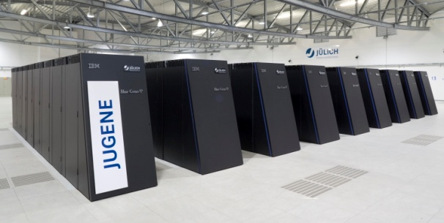
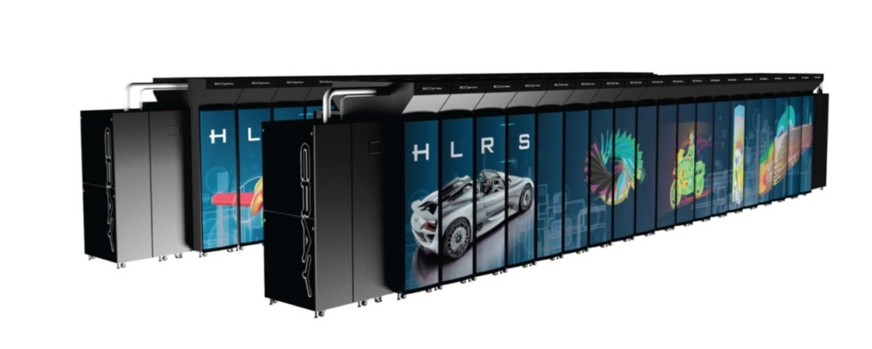
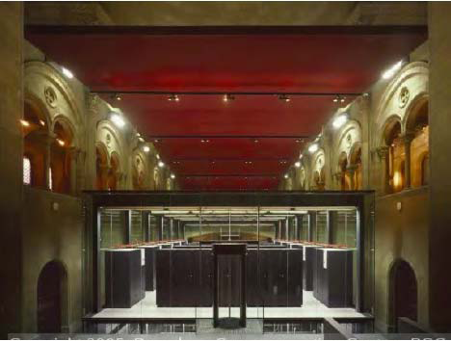
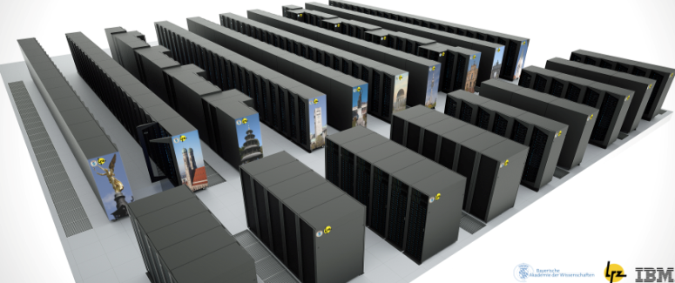
Tier-0 Petaflop-Capability in PRACE
BlueGene/Q 5.87 Petaflop/s PRACE@GCS@Jülich
Bull Cluster Curie 1.8 Petaflop/s
PRACE@GENCI@CEA
BlueGene/Q 1 Petaflop/s PRACE@CINECA
CRAY HORNET 4 Petaflop/s PRACE@GCS@HLRS
IBM SuperMUC 3 Petaflop/s PRACE@GCS@LRZ
MareNostrum 1 Petaflop/s PRACE@BSC
Notes:
12

Slide 13
e-IRG ESFRI Overarching Working Group (OWG)
Established April 1, 2014
e-IRG representatives in ESFRI WGs (SWG, Implementation, Innovation) + ESFRI representative invited + e-IRG Chair
Aim: bring the e-IRG participants in the SWGs together to aggregate the information received individually thus obtaining a more overall view of ESFRI’s e-Infrastructure requirements. This can facilitate identifying generic issues and prioritising possible e-IRG actions, and aggregated information can also be offered as input to ESFRI processes.
Life span: As long as needed

Slide 14
e-IRG White Paper 2014
Editorial board appointed April 1, 2014: e-IRG ESFRI OWG
Aim: Produce recommendations on issues emerging in the OWG – in the framework of the developing e-Infrastructure Commons
List of topics and preparatory material presented and discussed at e-IRG workshop and delegates meeting in June 2014
White Paper ready by the end of 2014
Strong ties and collaboration between ESFRI and e-IRG

Slide 15
Thank
you!
www.e-irg.eu

